Slide 1
Capstone Project 2019
IOS Team
Technical Presentation

Slide 2
Requirements Engineering

Slide 3
Constraints
Time
Experience
The Client
&
Domain Knowledge
Notes:
Issues Faced:
Scope of requirements changed a lot
Lack of domain experience made it difficult to fully grasp the requirements at the beginning
Different team members had different understanding of the requirements and it was difficult to bring everyone on the same page
Many functional requirements depended on the technical constraints. Due to the technical unknowns, it was also ambiguous whether some requirements should be considered or not
Studying the requirements revealed further unknowns, which were not communicated to the customer during the meeting. The team had to wait till the next meeting to clarify those and it created a delay in the progress of the work
Prioritizing the requirements due to time, experience and technical constraints was hard to tackle: internally prioritized list didn’t confirm with the customer’s prioritization. It also caused delay.

Slide 4
Methodology & Lessons Learned
Requirements Engineers
Team
Client
Notes:
Efforts to resolve:
Tried focusing on the requirements we were sure about to get started with the work
Scheduled customer meetings and internal meetings to discuss the requirements to check for ambiguities
Tried acting out the scenarios to get a real sense of application usage, to get a better idea of the requirements
Watched videos regarding farming to better understand the context of problem statement
Used simulated environments and different applications to understand the context of application usage
Carried the ambiguities to the next customer meeting for clarification
What could have been improved?
Communication with the customer could have been regulated, or made more open
Technical constraints that were blockers to some requirements should have been communicated early on
Prioritization of the requirements could have been done early on with all the constraints considered
Scope should have been kept small from the very start considering the constraints
People experienced in the context of usage should have been contacted if possible for better understanding

Slide 5
How we choose the features
The Map
Easy to use while driving, intuitive
With one glimpse, the user can get a lot of information
Getting Machine Alerts, Field Flags and Operation Updates
Since we display important events in the organization, we didn’t want to limit the user of not getting the details
User-friendly by using voice commands and suggestions
Notes
Giving the user an opportunity to store all the important notes at one place, gives a feeling of a well-rounded product
Notes:
Efforts to resolve:
Tried focusing on the requirements we were sure about to get started with the work
Scheduled customer meetings and internal meetings to discuss the requirements to check for ambiguities
Tried acting out the scenarios to get a real sense of application usage, to get a better idea of the requirements
Watched videos regarding farming to better understand the context of problem statement
Used simulated environments and different applications to understand the context of application usage
Carried the ambiguities to the next customer meeting for clarification
What could have been improved?
Communication with the customer could have been regulated, or made more open
Technical constraints that were blockers to some requirements should have been communicated early on
Prioritization of the requirements could have been done early on with all the constraints considered
Scope should have been kept small from the very start considering the constraints
People experienced in the context of usage should have been contacted if possible for better understanding

Slide 6
Architecture
Capstone Project 2019 – IOS team

Slide 7


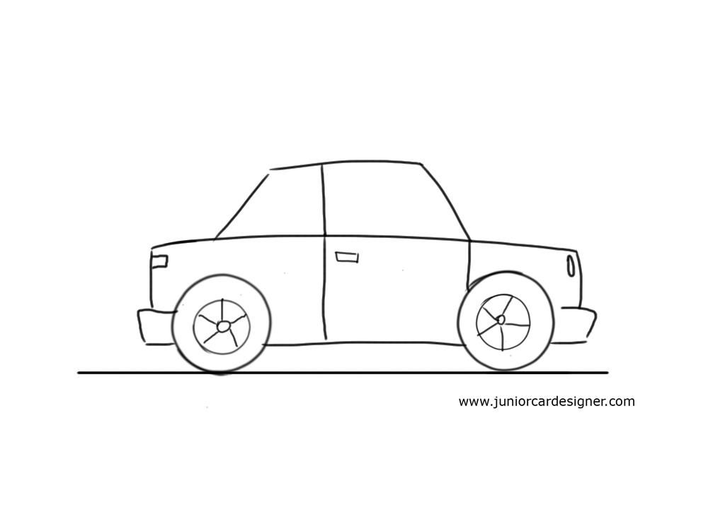


Introduction
Swift Version
Subscription Type
Car Model
Software Architect
IOS Car

Slide 8



Application Types
Voice and Messaging
Carmaker
Navigation
Playable Content

Slide 9
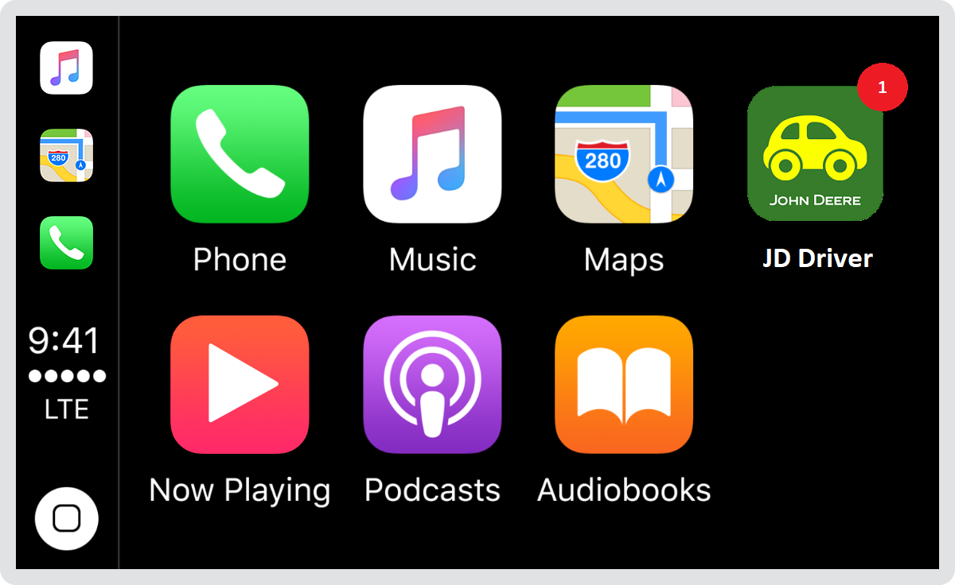
Basic Precautions
1. Badging​
2. Error Handling​
3. Loading​
4. Navigation​
5. Testing

Slide 10
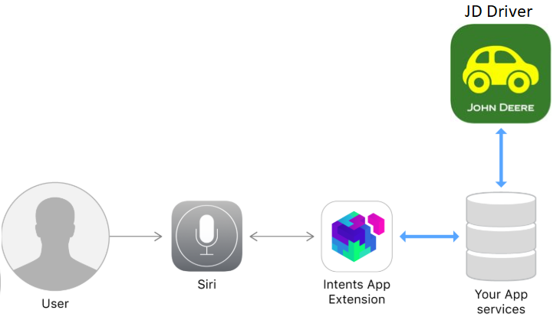
Architecture

Slide 11

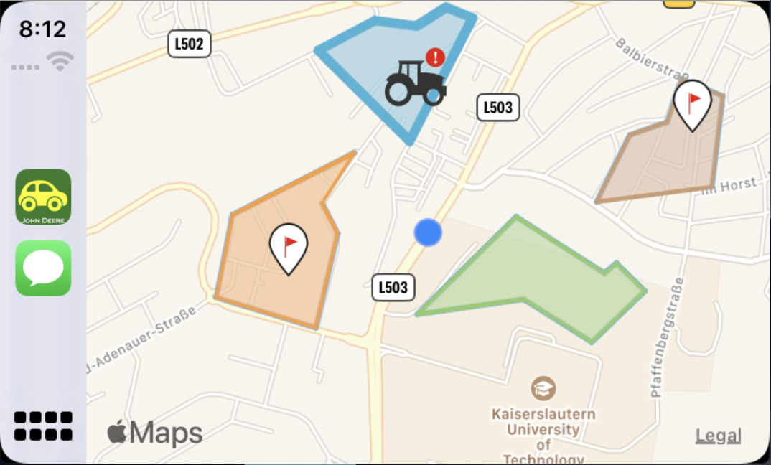

JD Driver
iPhone
Carplay

Slide 12
Architecture Layers - JD Driver
LaunchStoryboard
Storyboard
Xib
Front End
JohnDeere Controller
Scene Delegate
CarPlay Controller
Controllers
AppDelegate
Realm
Alomafire
BCrypt
Back End

Slide 13
Architecture Layers - Siri Intent
IntentsFile
Shortcut Donations
Shortcuts App
Front End
Machine Alert Handler
Fetch Updates Handler
Create Note Handler
Controllers
Machine Alert Target
Fetch Updates Target
Create Note Target
Siri Infrastructure
Targets

Slide 14
Development

Slide 15
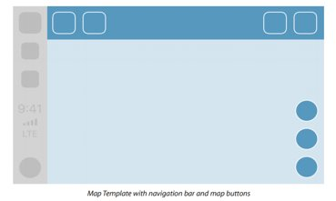

Introduction
Stack
Additional Elements...
MapTemplate
Base View

Slide 16
Base View
XIB File containing only MapKit Object.
Map has to cover whole screen and has to apply appropriate constraints
CarPlayController
Instance of Map from XIB file (reference)
1. Methods for drawing map
2. Methods for drawing overlays
3. Methods for drawing annotations
4. User Location (update)

Slide 17
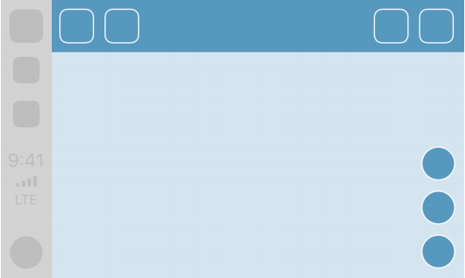
Map Template
Recenter
Panning

Slide 18
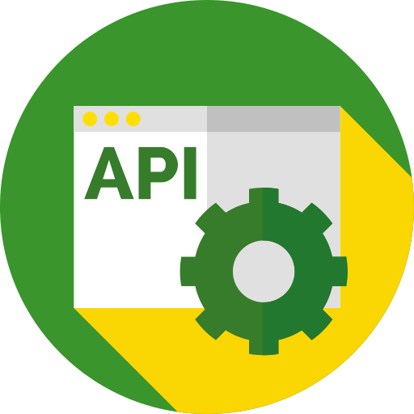

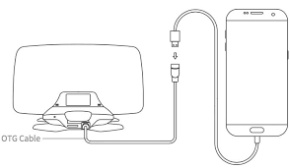
JD API Integration
JD API
JDOrganization
HTTP
JDField
...

Slide 19
JD API Integration: What we did?
Manual integration
JD Login
Show JDLogin screen and be able to authenticate
JD Framework
Framework in Objective-C is integrated into Swift app.
Alamofire for Swift
Could fetch data with existing token
JD Organizations
Fetch list of organizations and list of fields within an organization

Slide 20
JD API Integration: Observations
JD Framework
In Objective-C
Skills
Nobody had Mobile Application development experience
Required bridging implementation
No prior knowledge of Swift

Slide 21
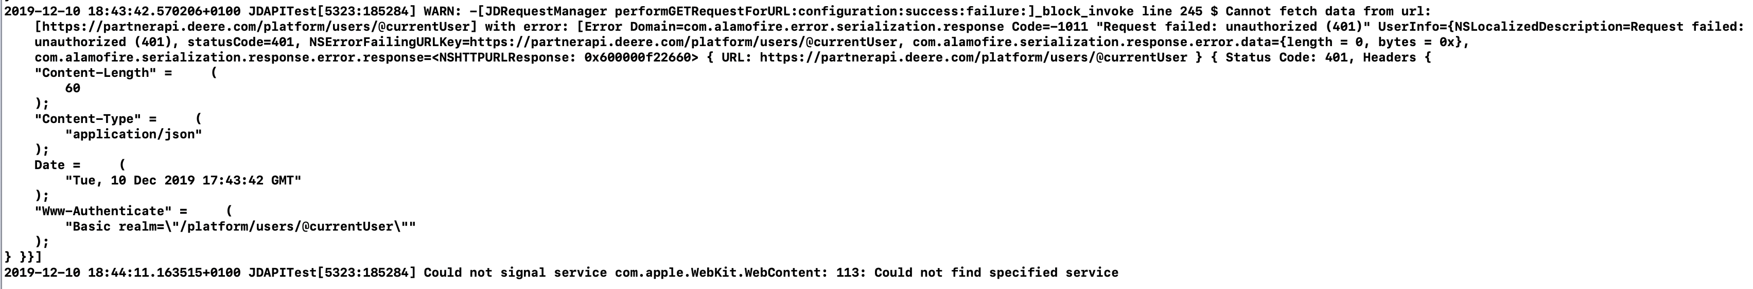
JD API Integration: Observations
JD Login
Misleading Error messages

Slide 22
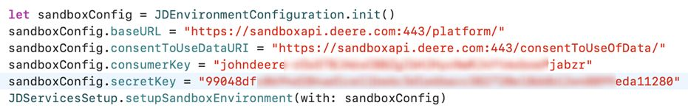
JD API Integration: Observations
JD fetch data
Inconsistency in workflow

Slide 23
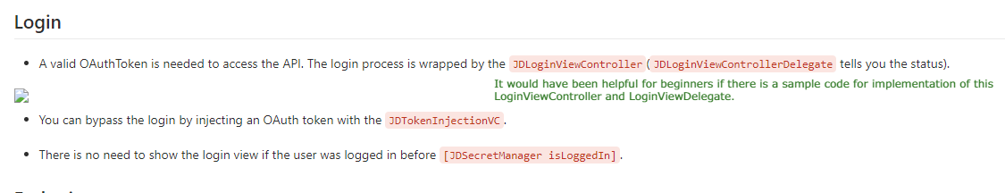
JD API Integration: Observations

Slide 24
Quality Assurance & Testing

Slide 25
JD Driver Testing Approaches
Functional Testing
Testing with Siri
Non-functional Testing
Compatibility
Code Quality
Code conventions
Naming Conventions
Unit Testing
Performance
Security
12.12.2019
Capstone Project 2019 – IOS team
Notes:
For quality assurance we followed different-different approaches such as “functional testing”, “non functional testing” also we ensured the code quality.
For functional testing we have written “unit testing” code and also tested “Siri” with the commands
For non-functional testing we tested the performance of our JD Driver apps, checked the compatibility of the application and also security testing
And also we followed the apple guidelines for the Code convention and naming conventions.

Slide 26
JD Driver Testing Process
Test Cases
Test Data
Test Results
Test Reports
Design Test Cases
Prepare Test Data
Run Program with Test Data
Compare Result with Test Cases
12.12.2019
Capstone Project 2019 – IOS team
Notes:
Speech: this is the whole JD Driver testing process.
1. Test Data is Our input
2. Test Result is out actual output
3. Design Test case: it specifies the ‘Input + pre-test state of the software` and the expected results of outputs and states.
4. Compare Result with test cases: Comparison process

Slide 27
Sample Test Case
TEST STEPS
INPUTS
EXPECTED OUTPUTS
ACTUAL OUTPUT
STATUS
LAST MODIFIED
Take a note
Connect JD Driver with car Ask Siri using voice command to take note. | User: “JD Driver take a note“ | Siri should ask for the field type Siri: “Of which type? Field or General“ | As expected | Pass | 06-12-2019
Connect JD Driver with car Ask Siri using voice command to take note. | User: “JD Driver testing and quality assurance“ | Siri: “ How can I help you with ?“ | As expected | Pass | 07-12-2019
Connect JD Driver with car Voice command for taking field type note | Siri: “Of which type? Field or General“ User: “field“ | Siri should ask the field name Siri: “For which field? Potato or Tomato field?“ | As expected | Pass | 07-12-2019
Connect JD Driver with car Voice command for taking field type note | Siri: “Of which type? Field or General“ User: “test field“ | Siri should ask the field name again Siri: “For which field? Potato or Tomato field?“ | As expected | Pass | 09-12-2019
Connect JD Driver with car Voice command for taking note on specific field. | Siri: “For which field? Potato field or Strawberry field?“ User: “Potato field“ | Siri: “Ok, tell me your note“ | As expected | Pass | 09-12-2019
Connect JD Driver with car Voice command for taking note on specific field. | Siri: “Ok, tell me your note“ | User: “remove tractor from potato field“ Siri should repeat the note and save it. | As expected | Pass | 09-12-2019
Connect JD Driver with car Voice command for taking note on specific field. | Siri: “For which field? Potato field or Strawberry field?“ User: “any field“ | Siri: “For which field? Potato field or Strawberry field?“ | As expected | Pass | 09-12-2019
Connect JD Driver with car Voice command for taking note on specific field. | Siri: “Ok, tell me your note“ User: “remove tractor from potato field“ | Siri: “You said ´remove tractor from potato field´, Do you want to save it? ” | As expected | Pass | 09-12-2019
Connect JD Driver with car Voice command for taking note on specific field. | Siri: “You said ´remove tractor from potato field´, Do you want to save it? | User: “yes” Note is saved on JD Driver | As expected | Pass | 09-12-2019
Take a note – Negative command
Take a field type note
Take a field type note – negative command
Take a note for the specific field
Take a note for the specific field
Take a note for the specific field – negative command
Save the note
Saved note
12.12.2019
Capstone Project 2019 – IOS team
Notes:
This is one of our successful test case, as an example we will explain one step of this test case.
Such as:
1. Take a field type note
2. If we ask siri to take a note for field, the siri will ask of which type field or general? Then based on that data the field note will be saved on JD Driver.
3. So it passed our testing criteria.

Slide 28
Quality Assurance Summary
Achievements
Unit Testing
Difficulties
Environment
Time
Domain knowledge
80 % Success cases
Code Quality
Performance test
12.12.2019
Capstone Project 2019 – IOS team
Notes:
This is the total summary of our quality assurance. Our achievements and difficulties throughout the project.
As an achievement, I want to say 80% of our cases were successful and we did unit testing, performance testing and we ensured the code quality.
But our success rate could be more if we could overcome the constraints such as
‘environment’, → we had no environment for testing our solution. Also, apple licensing issues
for ‘Domain knowledge’ → we all are not that familiar with farming or we didn’t had enough idea about the John Deere business domain
and also I would like to say that ‘time’ was a bit of constraints for us.

Slide 29

User Interface/ User Experience CarPlay Documentation

Slide 30
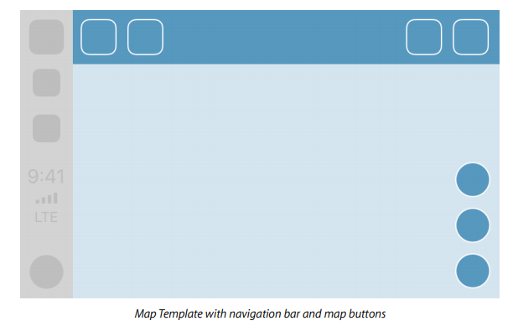
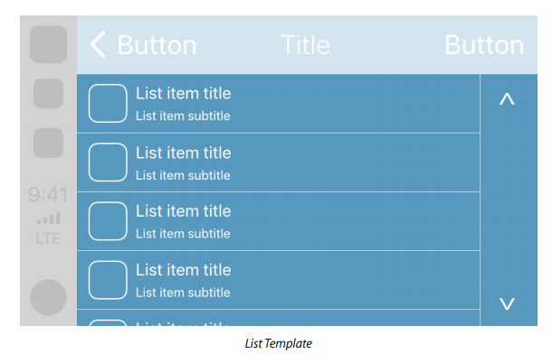
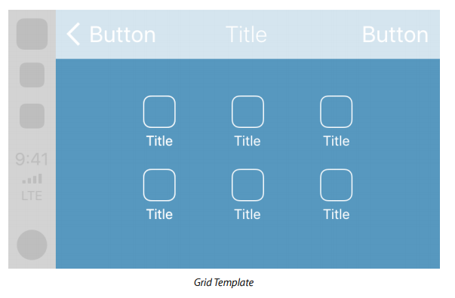
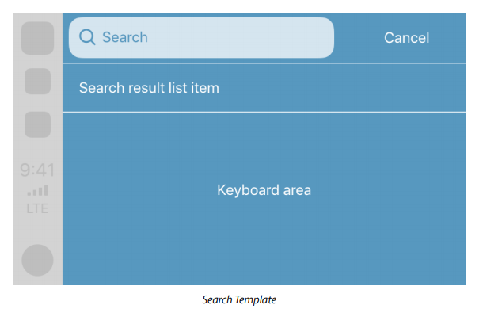
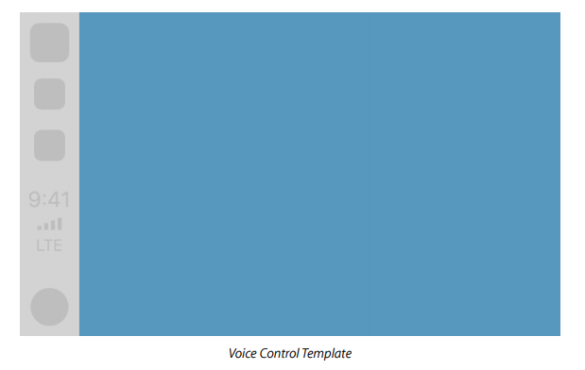
Navigation App Templates

Slide 31
CarPlay Navigation App
John Deere UX guidelines.
Apple developer UX guidelines.
CarPlay Navigation guidelines.

Slide 32
Project Management

Slide 33
Project Management (Responsibilities)
Use cases
Development
Requirements
API
Architecture
Quality Assurance
Prototyping

Slide 34
Project Management (Flow)
Ticket
Topic
Responsible Person
Developers
Acceptance Criteria
Workflow
Project Manager
Developer
Tester
Project Manager
Task distribution
Roles
Expertise

Slide 35
Project Management (Tools)
Sprint
Daily scrum
Kanban
Repository
Documentation
Communication
Pair programming

Slide 36
Project Management (Improvements)
Gitlab
Ticket
Communication
CI/CD
Tags
Story point
Estimation
Timesheet
Retrospective

Slide 37
Summary
Arian
Arif
Arinze
June
Katarina
Priyom
Raghad
Tayyaba Talant
Mahrukh
Nabid
Mr. Ralf Carbon
Mr. Patrick Haaser
Functional requirements
Use cases
Architecture
Prototyping and UX design
CarPlay application
Testing
3D printing
Discussion, R&D, idea
Supervisors

Slide 38
Thank You ☺

Slide 39
JD Driver
iPhone
Carplay

Slide 40
Project Management (Methodologies)
AGILE
Sprint
Scrum
GITLAB
Ticket
Kanban
REPOSITORY
Branch
Wiki

Slide 41
CarPlay Classes
class CPWindow : UIWindow
class CPInterfaceController : NSObject
func setRootTemplate(CPTemplate, animated: Bool)
class CPMapTemplate: CPTemplate
class CPMapButton: NSObject

Slide 42
MapKit Classes
class MKMapView : UIView
protocol MKAnnotation
protocol MKOverlay
class MKOverlayRenderer: NSObject

Slide 43
Realm Classes
class Realm
class Realm.Configuration

Slide 44
Siri Classes
class Intent : INIntent
class IntentResponse : INIntent

Slide 45
Base View
XIB File containing only MapKit Object.
Map has to cover whole screen and has to apply appropriate constraints
CarPlayController
Instance of Map from XIB file (reference)
1. Methods for drawing map
2. Methods for drawing overlays
3. Methods for drawing annotations
4. User Location (update)

Slide 46
CarPlay Navigation Guidelines Followed
The base view must be used exclusively to draw a map
Do not instruct the user to perform tasks on iPhone
Provide a way to enter panning mode.
Immediately terminate route guidance when requested
Supported countries
Notes:
The base view must be used exclusively to draw a map. Do not draw windows, alerts, panels, overlays, or user interface elements in the base view.
Do not instruct the user to perform tasks on iPhone. It’s not appropriate to ask the user to manipulate their iPhone while using CarPlay. If there is an error condition, such as a required log in, just inform the user of the error so they can take action when safe.
Provide a way to enter panning mode. If your app supports panning, you must include a button in the map template that allows the user to enter panning mode since drag gestures are not available in all vehicles. Drag gestures must only be used for panning the map.
Immediately terminate route guidance when requested. For example, if the user starts route guidance using the vehicle’s built-in navigation system, your app delegate will receive a cancelation notification and must immediately stop route guidance.
Supported countries. Ensure that your map is appropriate in each supported country.

Slide 47
CarPlay Siri Guidelines Followed
Siri is an essential feature of CarPlay that facilitates distraction-free, voice-driven app interactions.
Respond quickly and minimize interaction
Increase accuracy with custom vocabulary
Notes:
A voice command button on the steering wheel activates Siri, even when CarPlay isn’t visible on the car’s built-in display. Once activated, Siri handles the language processing and semantic analysis needed to turn spoken requests into actionable instructions your app can handle. You’re responsible for defining the tasks your app handles. Your app must validate the information it receives, provide information for Siri to present, and take action. While validating information, if something is missing or unclear, your app can instruct Siri to request confirmation or more information.
Respond quickly and minimize interaction. People use Siri for convenience, so don't make them wait for a response. Your app should validate information and take action as quickly as possible after receiving a request. When clarification or additional information is needed, present efficient, focused choices that reduce the possibility of additional prompting.
Increase accuracy with custom vocabulary. Help Siri learn more about the actions your app performs by defining specific terms people might use in requests. These terms should be nongeneric and unique to your app. Never include other app names, terms that are obviously connected with other apps, inappropriate language, or reserved phrases, such as “Hey Siri.” Note that any terms you define are used by Siri to help resolve requests, but aren’t guaranteed to be recognized.

Slide 48
Introduction: CarPlay Navigation
CarPlay navigation apps are designed to look and feel like your app on iPhone with familiar UI elements. Our application is optimized for the driving environment with brief interactions without commanding the driver’s attention and uses Siri interactions.
The on-screen information is minimal and relevant.

